Slide 1
BigData case study

Slide 2

Table of Contents
01
02
03
04
Introduction
Architecture / Data format
Configurations & Challenges
Final Result

Slide 3
01
Introduction

Slide 4
Fetching Data from Twitter to Kafka topic
Streaming Data & transformation using spark
Creating DashBoards using PowerBI

Slide 5
02
Architecture / Data format

Slide 6








Data Pipline

Slide 7
Data format
tweet_id = tweet.id_str
text = tweet.text
created_at = normalize_timestamp(str(tweet.created_at))
followers_count = tweet.user.followers_count
user_location = tweet.user.location
favorite_count = tweet.favorite_count
retweet_count = tweet.retweet_count
1390575207107158021;1 million postal votes already cast in Scotland and counting starts in 11 mins because of #COVID21 Yeha I am sure;2021-05-07 07:52:19;687;Glasgow;1;0;
Message = result of Sentiment analysis process in spark

Slide 8
03
Configurations & Challenges

Slide 9
Configurations
API Tweepy
consumer_key = 'vKxYzdyW3jQtwRyfSC5NHItF5'
consumer_secret = '01W4YmQbmzscKNj7FNDNDxBSSuLx9rW6BWh7jyYcoc4PtYp9TP'
access_token = '1385704300891058187-4jStql55dprbl9tahjE4c0OeRWCj9V'
access_token_secret = 'qmGwuJV2OF2KfcS2HiZ4MUtPW1JfojsXgY9cYHrsEaHOw'
auth = tw.OAuthHandler(consumer_key, consumer_secret)
auth.set_access_token(access_token, access_token_secret)
api = tw.API(auth)
Python environment to use python 3 instead of python 2 on machine.

Slide 10
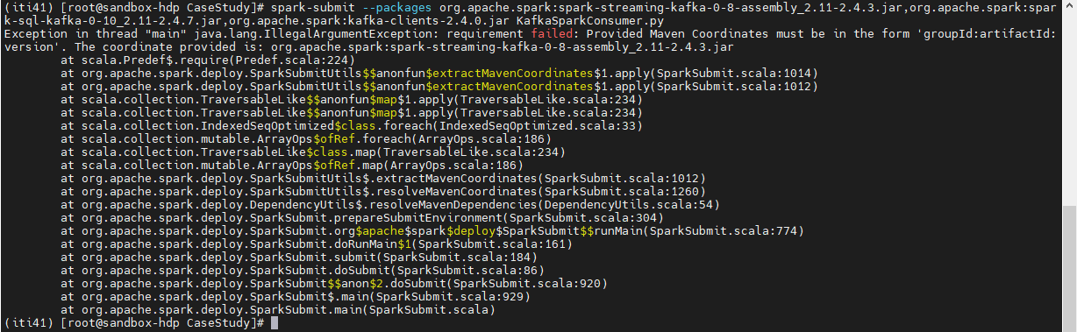
Challenges
spark-streaming-kafka-0-10_2.12:2.4.3
spark-sql-kafka-0-10_2.11:2.4.3
option("path", "hdfs:///CaseStudy/OutputStream")
option("path", "hdfs://sandbox-hdp.hortonworks.com:8020/CaseStudy/OutputStream")
tweepy.error.TweepError: Twitter error response: status code = 401
sudo timedatectl set-timezone Africa/Cairo
date -s "02 MAY 2021 15:30:00"

Slide 11

Future work
Using streaming Tweepy API function
Creating my own sentiment analysis
Enhance some function in my code

Slide 12
Lesson learnt
Work on Big case study and learn how too integrate many tool together
Learn how to use spark streaming on Kafka topic
Learn how to scrapping data from Social media platform as Twitter

Slide 13
04
Final result

Slide 14
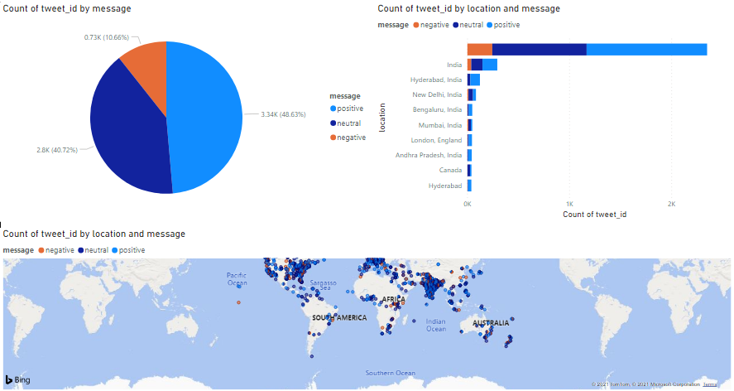
Dashboards

Slide 15
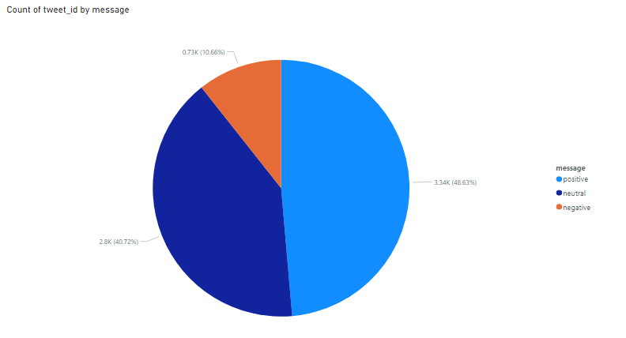
What are count Tweet ID per each Message?

Slide 16
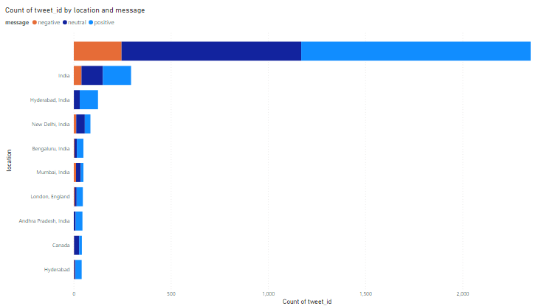
What are count Tweet ID per location & Message?

Slide 17
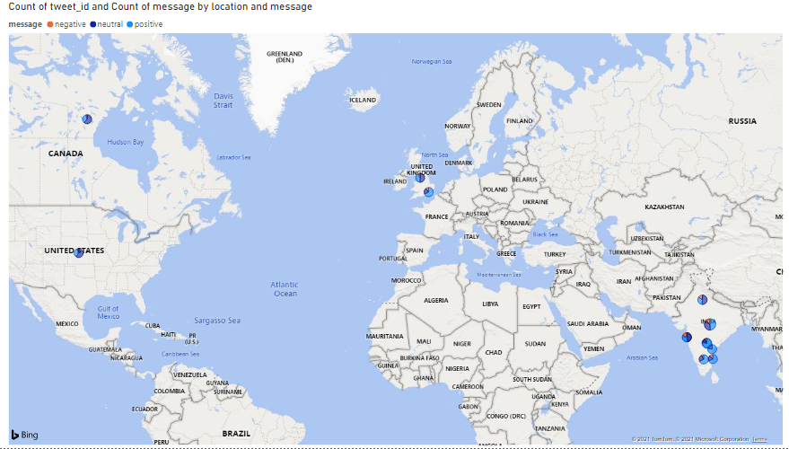
Top 10 Countries have tweets

Slide 18
Demo

Slide 19
Thanks!

